Slide 1
Crafting Wicked Domain Models
Jimmy bogard
@jbogard
jimmy@headspring.com

Slide 2
What is a domain model?
Notes:
From PoEAA: An object model of the domain that incorporates both behavior and data.
Key – data AND behavior
Beyond nouns and verbs

Slide 3
Why should I care?
Notes:
A lot of times – you shouldn’t
When you should – complex domain, or a long-lived project where behavior gets added piece by piece

Slide 4
Good news
Notes:
We can delay the decision and design until it’s needed

Slide 5
Current State

Slide 6
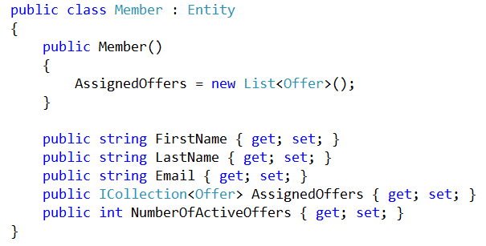
Notes:
Loyalty program
Looks rich, right?

Slide 7
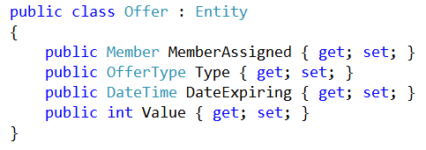
Notes:
Loyalty program
Looks rich, right?

Slide 8
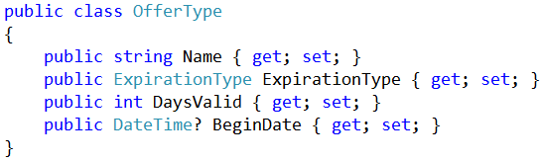
Notes:
Loyalty program
Looks rich, right?

Slide 9
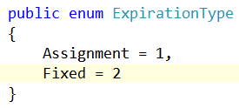
Notes:
Loyalty program
Looks rich, right?

Slide 10
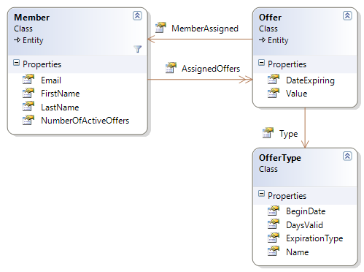
Notes:
Loyalty program
Looks rich, right?

Slide 11
Where’s the behavior?

Slide 12
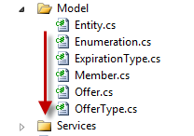

Slide 13
Anemic domain models
Notes:
The basic symptom of an Anemic Domain Model is that at first blush it looks like the real thing. There are objects, many named after the nouns in the domain space, and these objects are connected with the rich relationships and structure that true domain models have. The catch comes when you look at the behavior, and you realize that there is hardly any behavior on these objects, making them little more than bags of getters and setters. Indeed often these models come with design rules that say that you are not to put any domain logic in the the domain objects. Instead there are a set of service objects which capture all the domain logic. These services live on top of the domain model and use the domain model for data.

Slide 14
Pop the hood

Slide 15
Offer Assignment Service

Slide 16
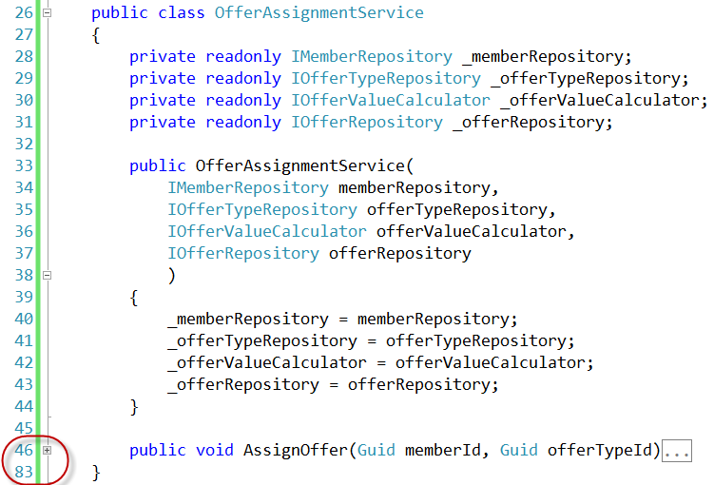

Slide 17
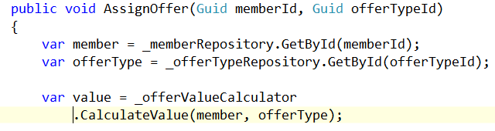

Slide 18
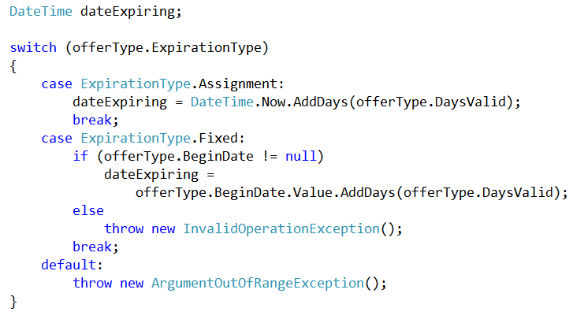

Slide 19
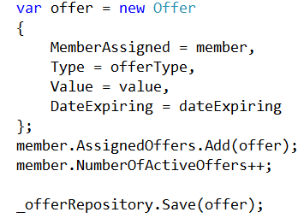

Slide 20
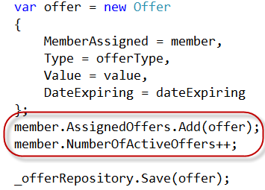

Slide 21
Behavior is there…

Slide 22
…but in the wrong place!

Slide 23
Solution
Notes:
Paying attention to code smells, model smells, OO and refactoring

